Slide 1
UAV Route Planning Strategies for Efficient Coverage Search in Complex Environments
Gabriel Rovesti
Exam of 19th September 2024
Prof. Claudio Enrico Palazzi
Wireless Networks for Mobile Applications
2023-2024

Slide 2
Table of contents
Introduction
Overview of approaches
Classical approaches
Probabilistic methods
Nature-inspired algorithms
Multi-UAV coordination
Environment-specific approaches
Military applications
Military applications
Comparison of approaches
Future challenges and research directions
Conclusions

Slide 3
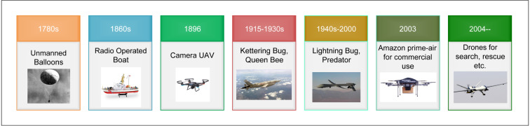
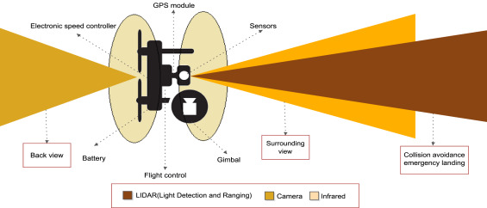
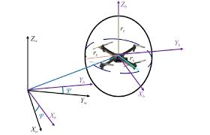
UAV Route Planning
Reference: https://www.sciencedirect.com/science/article/pii/S0140366419308539

Slide 4
Overview of approaches
Classical algorithms
Probabilistic methods
Nature-inspired algorithms
Multi-UAV coordination
Environment-specific approaches
Military applications

Slide 5
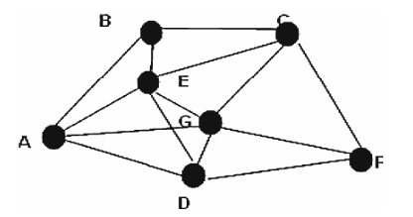
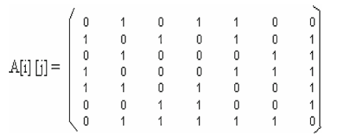
Classical approaches
Dijkstra’s Algorithm
A* Algorithm
Bellman-Ford Algorithm
Floyd-Warshall Algorithm
Reference: Multiple UAVs path planning algorithms: a comparative study (Paper 1)

Slide 6
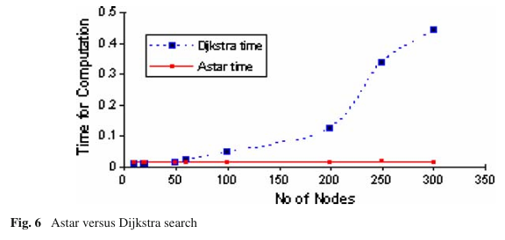
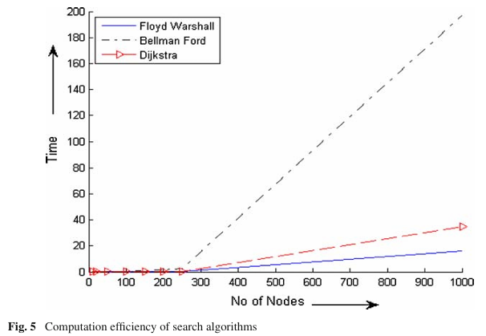
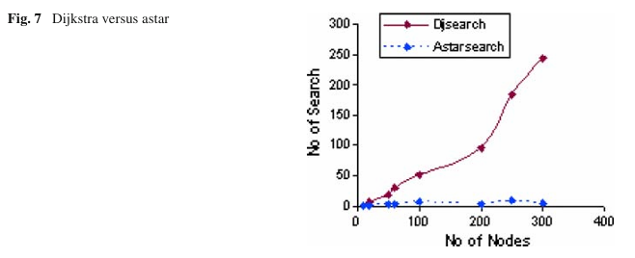
Classical approaches
Reference: Multiple UAVs path planning algorithms: a comparative study (Paper 1)

Slide 7
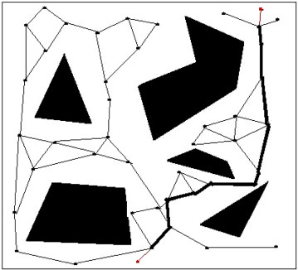
Probabilistic methods
Probabilistic Roadmap Method (PRM)
Efficient for high-dimensional configuration spaces
Two phases: learning phase and query phase
Handles complex 3D environments effectively
Key features
Random sampling of configuration space
Creation of roadmap for path planning
Efficient for large/complex environments
Reference: https://www.sciencedirect.com/science/article/pii/S0140366419308539

Slide 8
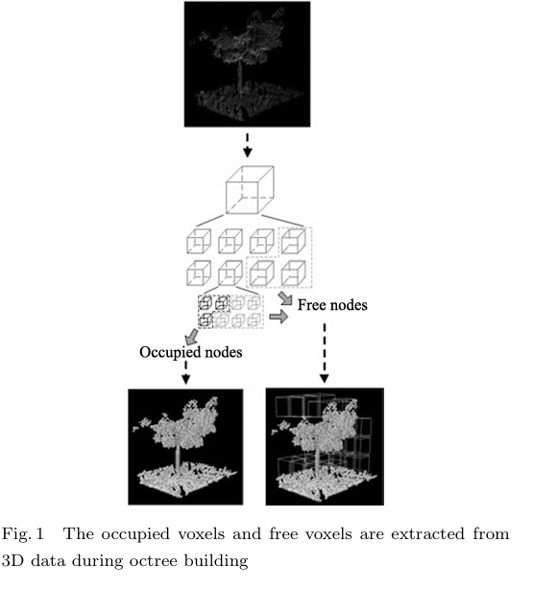
Probabilistic methods
Enhancements for UAV Applications
Octree-based environment representation
Safety-aware sampling
Bounding box array for focused sampling
Connectivity evaluation for feasible paths
Advantages
Handles obstacle avoidance well
Computationally efficient for large environments
Adaptable to different types of environments
Reference: Path Planning in Complex 3D Environments Using a Probabilistic Roadmap Method – (Paper 2)

Slide 9
Nature-inspired algorithms
Grey Wolf Optimization (GWO)
Inspired by social hierarchy and hunting behavior or grey wolves
Balances exploration and exploitation effectively
Particle Swarm Optimization (PSO)
Efficient for continuous optimization problems
Well-suited for dynamic UAV path plannig
Based on social behavior of bird flocking/fish schooling
Ant Colony Optimization (ACO)
Effective for discrete optimization and adaptive path planning
Mimics foraging behavior of ant colonies

Slide 10
Nature-inspired algorithms

Slide 11
Multi-UAV coordination
aa

Slide 12
Environment-specific approaches
aa

Slide 13
Military applications
aa

Slide 14
Comparison of approaches
aa

Slide 15
Future challenges and research directions
aa

Slide 16
Conclusions
aa

